Slide 1
Two Birds Publishing
ebook product update
Notes:
Hi everyone. Thank you all for joining me today to discuss our Ebook app Product Update. I know we all have busy schedules but I am grateful that you were able to make time for this meeting. Today we will cover team objectives, recent accomplishments, short term work, long term work, and we will finish all with our vision for the future. Feel free to stop me at any point and let me know if you have any questions. Lets jump straight into it

Slide 2
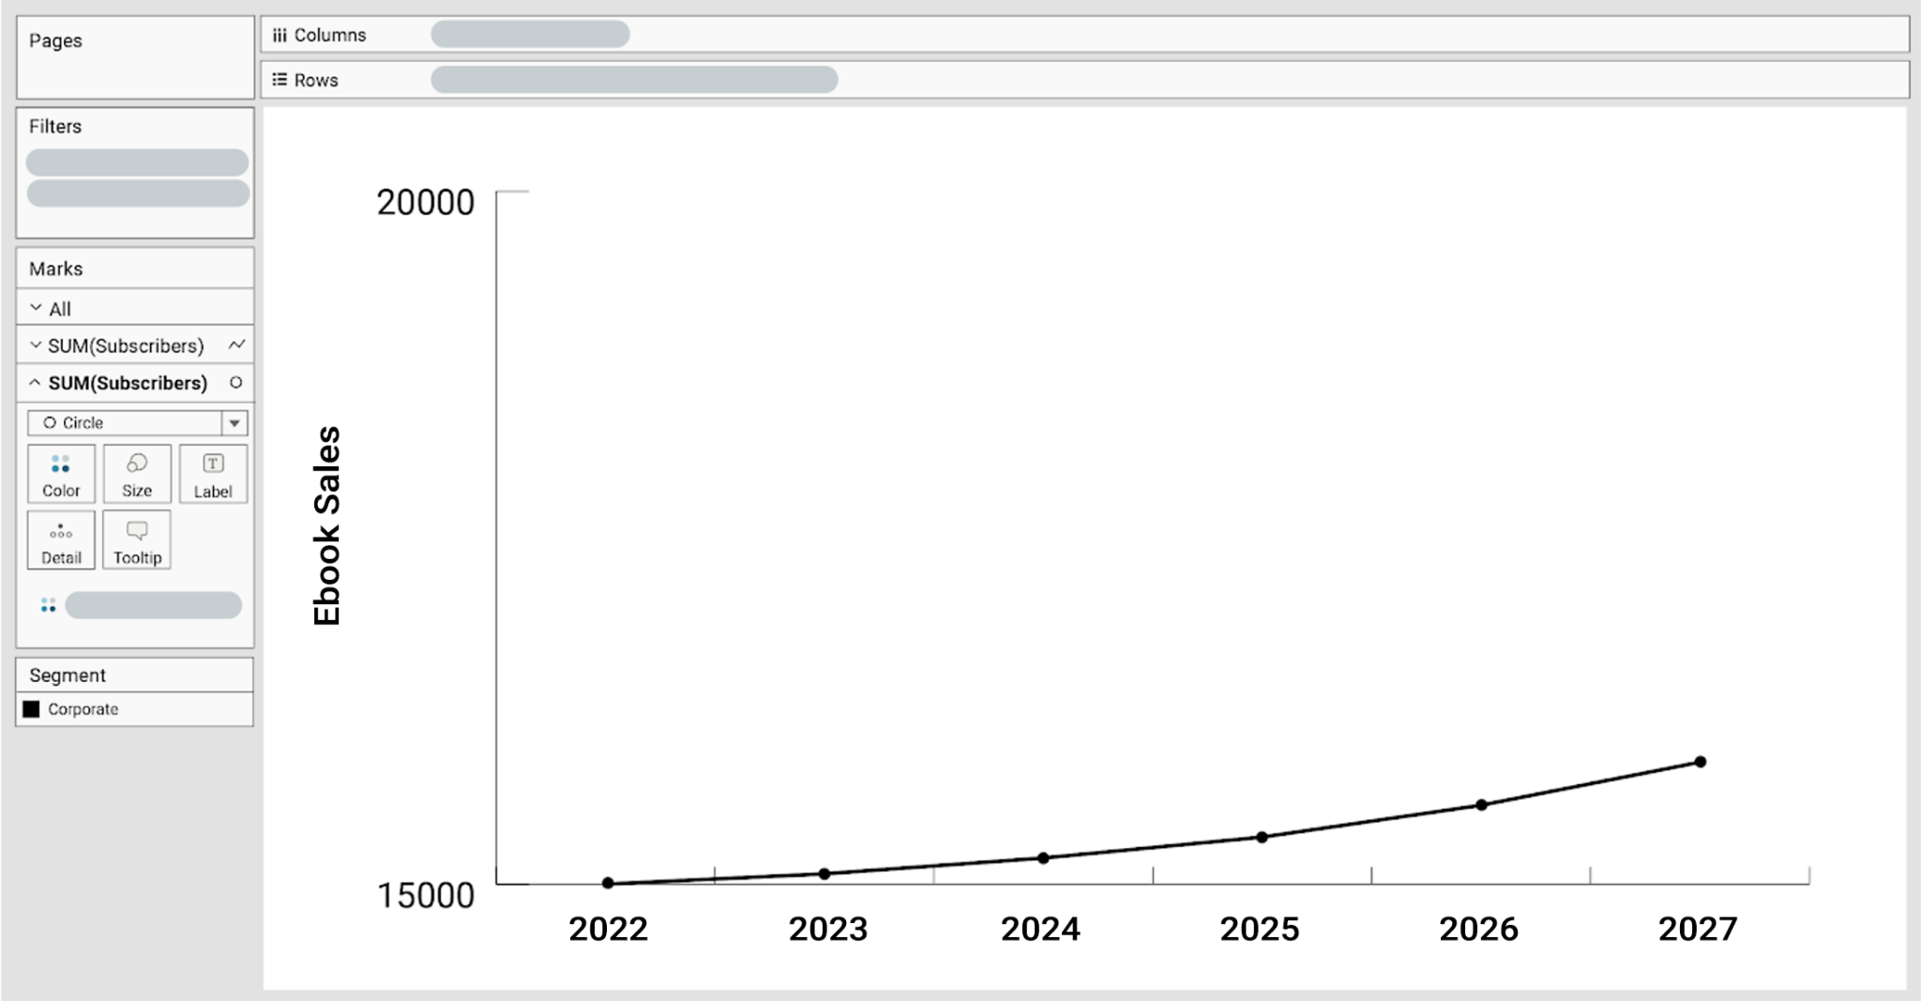
Team Objective
Goal 1: Ebook sales +11% YoY.
Currently +7%
Notes:
Our team’s objective is to achieve at least an 11% increase in digital ebook sales by the end of the year. Currently, we have seen a 7% increase in ebook sales for the previous quarter, which is below our projected 15% increase. However, we have made a great progress in developing new features for the ebook app that we believe will only drive our sales up.

Slide 3
Recent accomplishments
New Rewards program
Incentivizes users to engage more with our ebooks and provides a better experience
Progress on the UX update - Pending Release
Identified pain points and challenges, redesigned user interface that’s more user-friendly including improved search and browsing capabilities
Backend Infrastructure
Improved overall stability and performance of the app
Notes:
Our team has made significant progress over the past few weeks. We've released a major update to the Two Birds ebook app including a new rewards program that incentivizes users to engage more with our ebooks and provides a better experience overall. Unfortunately, we experienced some technical issues at launch that prevented some customers from accessing the rewards program. We have since resolved these issues and are working to improve the rewards program based on customer feedback.
In addition, we have made progress on the UX update for the ebook app, which we had previously put on hold to focus on the rewards program launch. We have identified pain points and challenges that our customers face when using the app, and we are developing solutions to improve the user experience. Some of these solutions including improved search and browsing capabilities, enhanced personalization features, and a redesigned user interface that is more user-friendly and accessible. We plan to complete and release the UX update within the next four months.
Lastly, we've made significant improvements to our backend infrastructure to improve overall stability and performance. We've also implemented several new security measures to better protect our users' data and privacy.
Overall, while we have faced some setbacks, we are making progress toward our objective and remain committed to delivering a great product experience for our customers.

Slide 4
Short-term Work
Addressing Technical Issues
Rewards Program issues
Conducting user research
Research to gain insights into our target groups (i.e commuter readers, busy professionals)
Finalizing the UX update for the ebook app
Final designs and development is in progress
Content curation
Adding new content to the app
Notes:
Over the next month, our team will be focusing on several key tasks to advance our product objectives:
Addressing technical issues: We are currently working to address any technical issues that arose with the recent launch of our rewards program. Our users couldnt access the new rewards program and get their early sign up bonus. This issue was common among Android users. We plan to continue monitoring and testing the program to ensure it is functioning smoothly for our customers.
Conducting user research: We plan to conduct additional user research to gain deeper insights into our target customer groups, including commuter readers and busy professionals. This research will help us identify any pain points or areas of improvement that we can address to better serve our customers.
Finalizing the UX update for the ebook app: Our team has made significant progress on the UX update, and we plan to complete the final design and development work over the next month. This update will improve the user experience and make it easier for our customers to navigate and enjoy our ebooks.
Content curation: We will continue to curate and add new content to our ebook library to cater to the diverse interests of our customers. This will involve identifying new titles, genres and authors to add to our collection and collaborating with publishers and authors to offer exclusive content to our customers.
By focusing on these key tasks over the next month, we are confident that we can continue to make progress towards our objectives of improving customer experience, increasing engagement, and driving ebook sales growth for Two Birds Publishing.

Slide 5
Long-term Work
Improving the rewards program
Enhance the program's functionality and continue to promote it
Completing the UX update for the ebook app
Navigation and usability of the app
Expanding our ebook offerings
New topics & Diverse Content
Front End Implementations
Several new security measures
Notes:
Over the next four months, our team plans to focus on four main areas of work:
Improving the rewards program: We received valuable feedback from our customers during the program's launch and have identified areas for improvement. We plan to make necessary adjustments to enhance the program's functionality and continue to promote it to increase customer engagement.
Completing the UX update for the ebook app: We have made significant progress on the UX update and plan to complete the project within the next four months. This update will improve the navigation and usability of the app, making it easier for our customers to find and read the books they love.
Expanding our ebook offerings: We plan to continue to expand our library of ebooks by adding more titles and genres that cater to our customers' interests and needs. This will include books on new topics, as well as more localized and diverse content. We believe that expanding our offerings will attract new customers and retain existing ones, ultimately driving ebook sales growth for the company.
Front End Implementations: We plan to implement the following changes to the front end including Two-factor authentication for login, Security questions inserted within the password reset request, and addition of biometric unlock (Face ID and/ or fingerprint for our mobile application to avoid any data breaches.
These areas of work align with our overall objective of increasing ebook sales by at least 11% by the end of the year, as set by the Two Birds executive team.

Slide 6
A Vision for the Future
"At Two Birds Publishing, we aim to provide a seamless, personalized reading experience that empowers our customers to discover and read engaging books from our diverse library on their mobile devices, anytime and anywhere.
Our early access to new publications and market-leading cross-device reading experience further distinguishes us from the competition and cements our position as the go-to destination for readers seeking relaxation, stress relief, self improvement and social connection."
Notes:
Crafting the vision statement involved a careful consideration of each stakeholder's concerns and perspectives, as well as the user personas and value proposition canvas. I focused on incorporating the key features and benefits that each participant emphasized, while also ensuring that the statement was clear, concise, and inspiring. Our vision for the future of Two Birds Publishing's ebook subscription product is to provide a personalized reading experience for our customers. We want to be the go-to source for readers of all backgrounds and interests, providing a vast library of books and a diversity of genres to choose from.
We also want to create a sense of community and social connection among our users, allowing them to engage with other readers and authors through our platform. Our goal is to not only provide a stress-free and cost-effective way for users to access their favorite books, but also to foster a love of reading and support the literary community as a whole.With a strong focus on continuous improvement and innovation, we aim to be the industry leader in digital ebook subscriptions and help shape the future of reading in the digital age.
This vision statement highlights the unique features and benefits of the product, while also emphasizing the importance of customer needs and experience. And most importantly, it will guide our product development in a way that meets the needs of our customers while also aligning with the business goals of Two Birds Publishing including the digital transformation strategy and the need to increase ebook sales.

